Slide 1
Data Warehousing SS ZG515
PC Reddy
Guest Faculty – WILP, BITS Pilani

Slide 2
Data Warehousing – Lecture 10
Physical DW design
Index strategy

Slide 3
Physical Design Steps
Develop standards
Create aggregates plan
Determine data partitioning
Establish clustering options
Prepare indexing strategy
Assign storage structures
Complete physical model

Slide 4
Develop Standards
IT standards include
Naming conventions for database and software
Procedures for documentation, information gathering, project organization, methodology, and process
Standards are of greater significance in data warehousing projects because they are large and complex projects with non-technical end-users

Slide 5
Create Aggregates Plan
Requirements guide creation of aggregates or summary tables
A comprehensive plan would
Identify key dimensions and their hierarchical levels that can be aggregated
Provide guidelines on when to include an aggregate table (e.g. based on some performance metric)
Establish monitoring of usage (types of queries and their performances)

Slide 6
Determine
Data Partitioning Scheme
Fact tables can become very large. It is essential that they are properly partitioned among different physical platforms to improve performance.
The partitioning scheme would include
The fact tables and the dimension tables selected for partitioning
The type of partitioning for each table – horizontal or vertical
The number of partitions for each table
The criteria for dividing each table (for example, by product groups)
Descriptions of how to make queries aware of partitions

Slide 7
Establish Clustering Options
Establish physical location of data elements for quick access
If data elements are read sequential most of the time, then they should be placed in adjacent locations on the disk

Slide 8
Prepare an Indexing Strategy
Adequate indexing can improve query performance significantly
An indexing strategy would include
Indexes for each table
The sequence in which indexes will be created for each table
Create some indexes initially
Monitor performance and plan to add more indexes as need is felt

Slide 9
Physical Design Objectives
Improve performance
Ensure scalability
Manage storage
Provide ease of administration
Design for flexibility

Slide 10
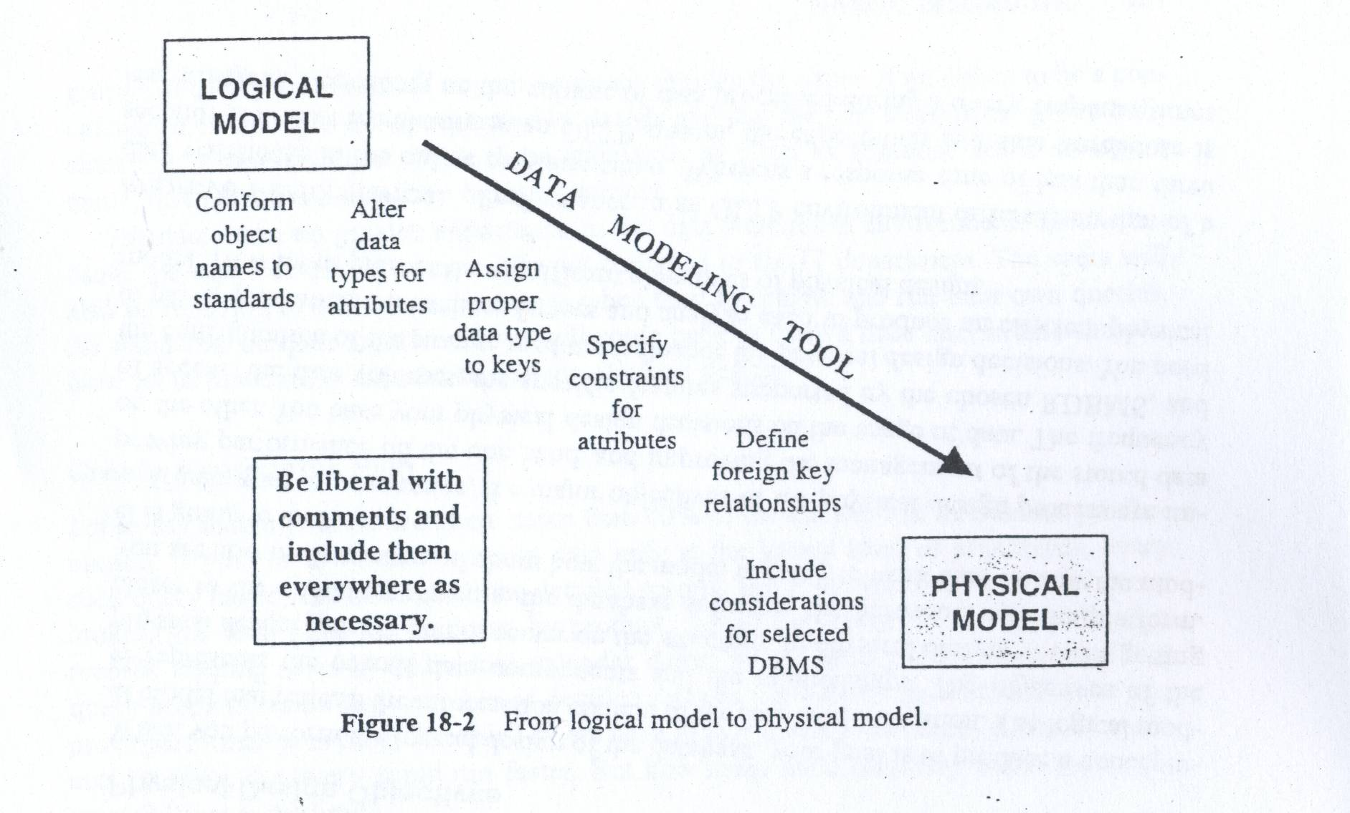
Logical Model to
Physical Model

Slide 11
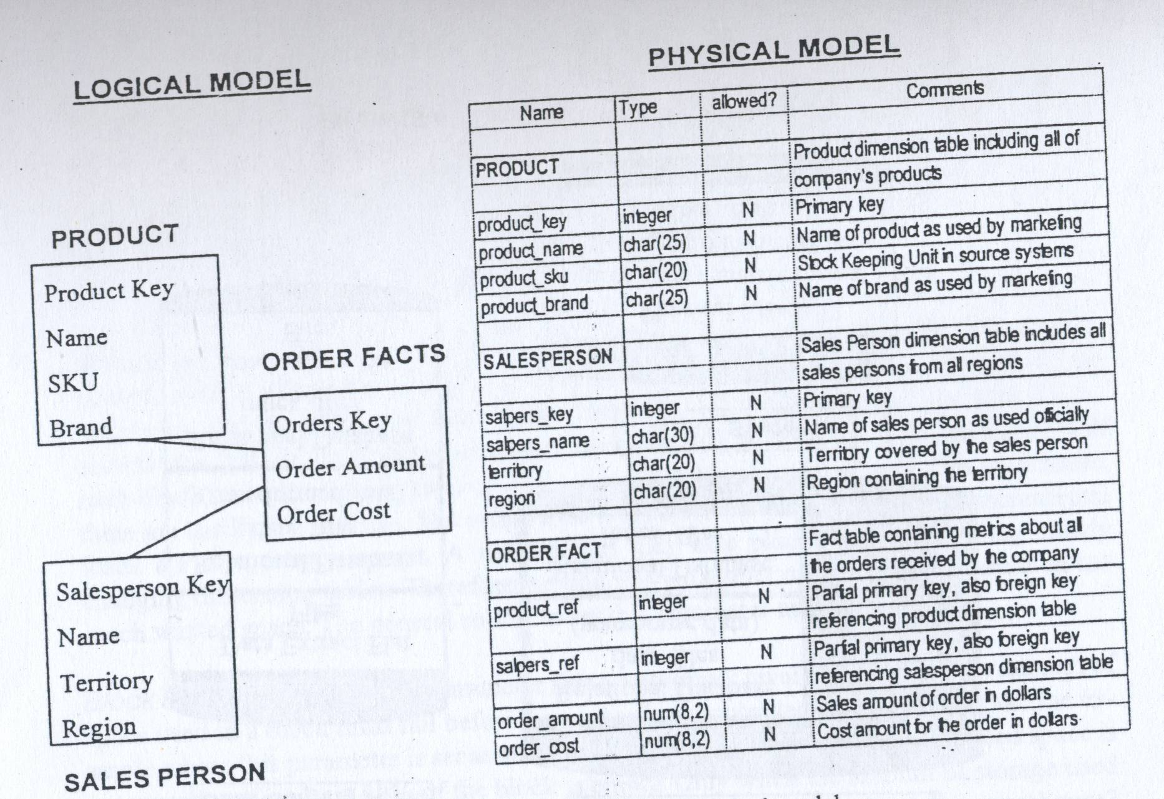
Logical Model to
Physical Model

Slide 12
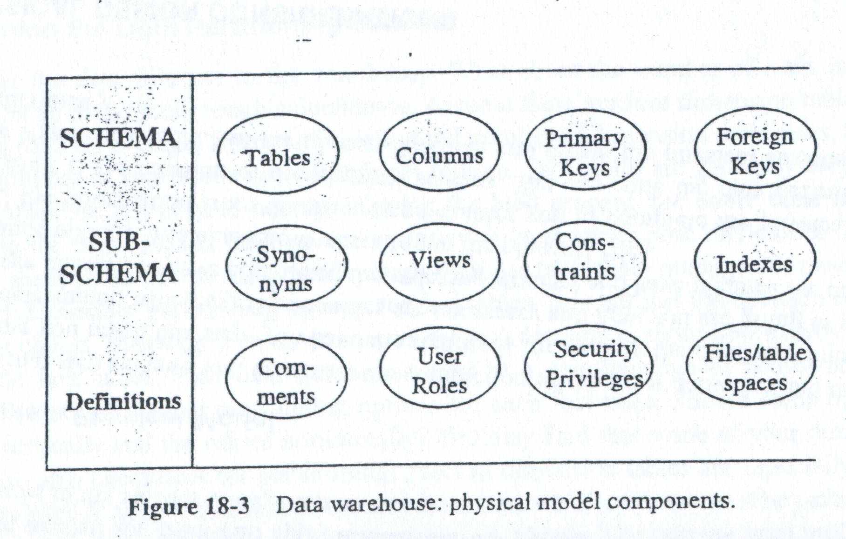
Physical Model Components

Slide 13
Standards
Naming of database objects
Components of object names
Word separators
Names in logical and physical model
Naming of files and tables in the staging area
Indicate the process
Express the purpose
Standards for physical files
Files holding source codes and scripts
Database files
Application documents

Slide 14
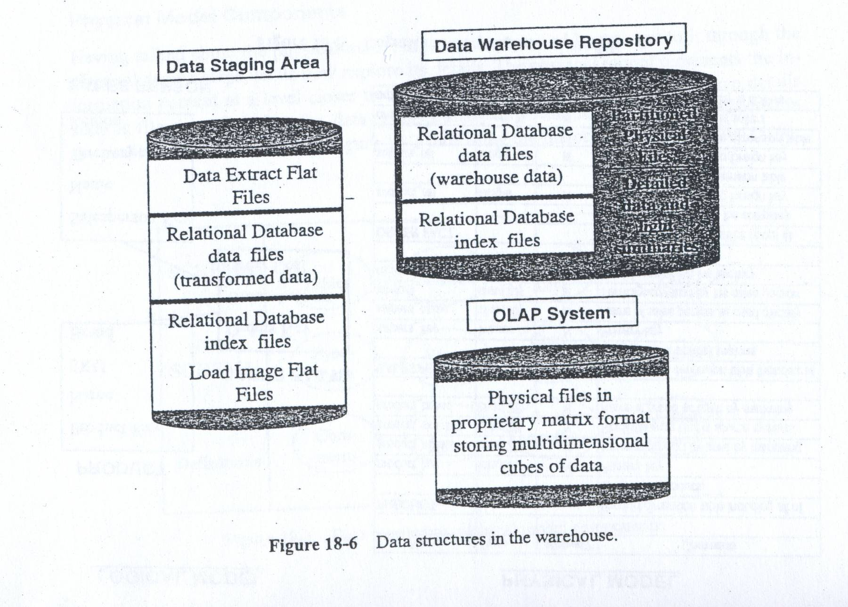
Physical Storage Data Structures

Slide 15
Optimizing Storage
Set the correct block size
Set the appropriate block usage parameters
Block percent free; block percent used
Manage data migration
Resolve dynamic extensions
Employ file striping techniques

Slide 16
Using RAID Technology
Redundant array of inexpensive disks
Data mirroring
Data duplexing
Data striping
Six levels of RAID implementations
(RAID 0 to RAID 5)

Slide 17
Estimating Storage Sizes
For each database table, determine
Initial estimate of the number of rows
Average length of the row
Anticipated monthly increase in the number of rows
Initial size of the table in megabytes (MB)
Calculated table sizes in 6 months and in 12 months
For all tables, determine
The total number of indexes
Space needed for indexes initially, in six months, and in 12 months
Estimate
Temporary work space for sorting and merging
Temporary and permanent files in the staging area

Slide 18
Indexing
Goal: Increase efficiency of data access by reducing the number of I/Os required to find desired record(s).
Library analogy: Indexed access is analogous to using the card catalog in a library rather than searching through every shelf in the library until the desired book is found (e.g. , avoids full table scan).

Slide 19
DW Indexing Issues
Indexes and loading
Indexing for large tables
Index-only reads
Selecting columns for indexing
A staged approach

Slide 20
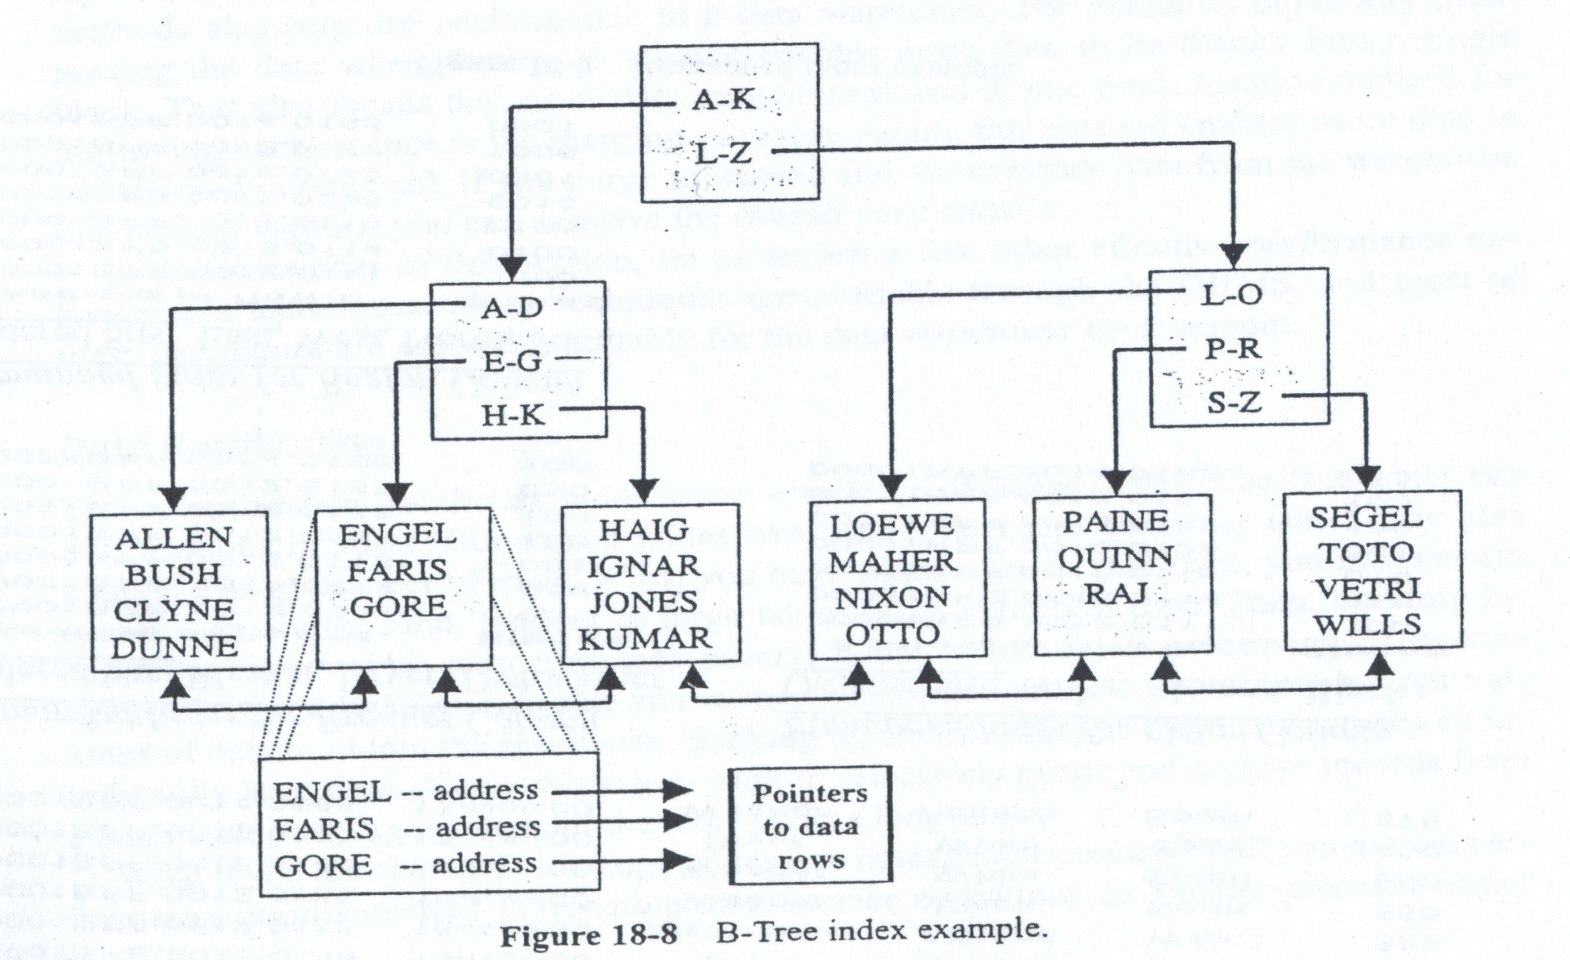
B-Tree Index

Slide 21
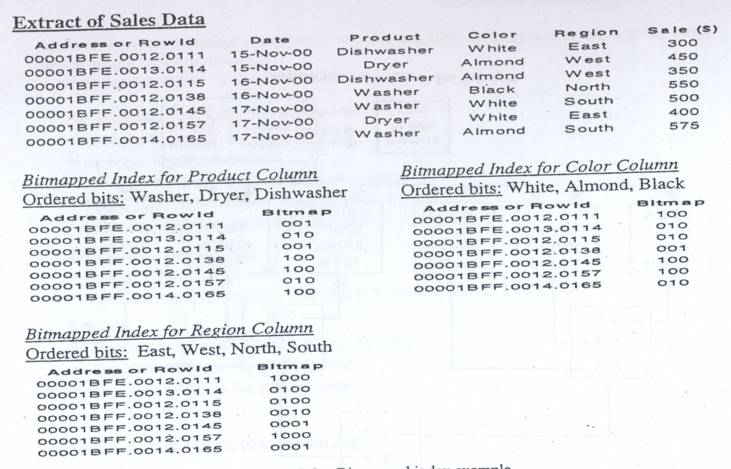
Bitmapped Index

Slide 22
Indexing the Fact Table
If the DBMS does not create an index for the primary key, create one using B-tree indexing
In the concatenated primary key, place the primary keys of frequently accessed dimension tables in the top order
Create indexes for combinations of dimension table primary keys based on query performance
Do not overlook indexing metric columns
Bitmapped indexing does not apply to fact tables; there is hardly any low-selectivity columns ????

Slide 23
Indexing Dimension Tables
Create a unique B-tree index on the single-column primary key
Index any column that is used frequently to constrain queries
Create index for combination of columns that are used frequently together in queries
Index every column likely to be used in a join operation

Slide 24
Hash Indexing
In contrast to B-tree indexing, hash based indexes do not (typically) keep index values in sorted order.
Index entry is located by hashing index value.
Index entries keep in hash organized tables rather than B-tree structures.
Index entry contains ROWID values for each row corresponding to the index value.
ROWIDs kept in sorted order to facilitate maximum I/O performance.

Slide 25
Primary Indexing
Primary index for a table in Teradata is a specification of its partitioning column(s).
Primary index may be defined as unique (UPI) or non-unique (NUPI).
Automatic enforcement of uniqueness when UPI is specified.
Primary index provides an implicit access path to any row just by knowing its value.
Only one primary index per table.

Slide 26
Primary Indexing
Primary index selection criteria:
Common join and retrieval key.
Distributes rows evenly across database partitions.
Less than ten thousand rows per PI value when non-unique.

Slide 27
Primary Indexing
Trick question: What should be the primary index of the transaction table for a large financial services firm?
create table tx
(tx_id decimal (15,0) NOT NULL
,account_id decimal (10,0) NOT NULL
,tx_amt decimal (15,2) NOT NULL
,tx_dt date NOT NULL
,tx_cd char (2) NOT NULL
....
) primary index (???);
Answer: ????.

Slide 28
Primary Indexing
Almost all joins and retrievals will come in through the account _id foreign key.
Want account_id as NUPI.
if accounts have very large numbers of transactions (e.g., an institutional account could easily have 10,000+ transactions).
Want tx_id as UPI for good data distribution.

Slide 29
Primary Indexing
Joins and access via primary index are very efficient due to Teradata’s sophisticated row hashing algorithms that allow going directly to the data block containing the desired row.
Single I/O operation for accessing a data row via UPI.
Single I/O operation for accessing a data row via NUPI whenever all rows with the same PI value fit into a single block.
Single VAMP operation for indexed retrieval.
No spool space required.

Slide 30
Primary Indexing
Primary index is free!
No storage cost.
No index build required.
This is a direct result of the underlying hash-based file system implementation.
OLTP databases use a page-based file system and therefore do not deliver this performance advantage.

Slide 31
Bottom line
Optimizer sophistication is critical in effectively exploiting indexes.
Selectivity of indices are critical in determining their usefulness.
Indexed access paths are not nearly as useful in data warehousing as compared to OLTP workloads.

Slide 32
Questions
???

